Slide 1
Working Group Numbering & Networks
Freddie McBride, European Communications Office
Third CEPT workshop on “European Spectrum Management and Numbering”
ECO, 4 June 2014
Notes:
Ladies and Gentelemen – Pleasure and privilege
My name is, eco. Tell you more
I want you to consider my presentation as food for thought in terms of the future development of NP systems.
The way consumers purchase and consume communications services is changing. Namely bundling.
These changes will have a fundamental impact on the future development of national telehone numbering plans and management o that resource. Consequently, NP systems, processes and procedures will be affected also.
Until now, NP has been a vary successful competition enabler. It needs to remain so in the new environment.

Slide 2
Contents
Numbering briefly
How National Numbering Plans are structured
ITU-T E.164
ITU-T E.212
Legal Basis for Numbering in Europe
Organisation of WG NaN
Current Work Items
Third CEPT workshop on “European Spectrum Management and Numbering”
ECO, 4 June 2014
Notes:
Firstly a little bit of background on me and the organisation I represent.

Slide 3
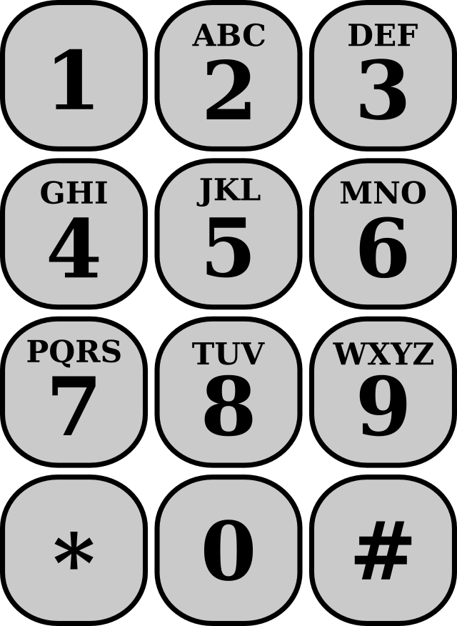
Numbering – Briefly!
A key enabler of communications services
A scarce resource that needs to be managed
Competition – New Market Entrants and Number Portability
Innovation – New number ranges for new types of services
Consumer protection – Access to emergency services, premium rate services, freephone, roaming etc.
Harmonisation – 112, 116, 118, rights of use
Capacity planning, mitigating risk of exhaustion
Third CEPT workshop on “European Spectrum Management and Numbering”
ECO, 4 June 2014

Slide 4
How National Numbering Plans are structured
Level | Typical Designation
0 | 0 – Trunk dialling, 00 - international dialling (open dialling plans only)
1 | Special services – 1800 freephone, 112, 116, 118, shared cost numbers
2-8 | 2-8 – Geographic numbers, mobile numbers, IP based numbers, SMS short codes
9 | emergency services – 999, 911 and premium rate in some countries
National dialling plans are legacies of the original PSTN in a country
Open and closed dialling plans (local dialling)
Changes are usually capacity driven or where new numbers for new services are needed.
Number changes are costly so important to get it right first time!
Other non-visible numbering resources – NSPCs, ISPCs etc
Third CEPT workshop on “European Spectrum Management and Numbering”
ECO, 4 June 2014

Slide 5
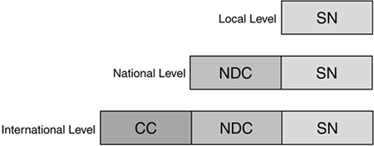
ITU-T E.164
Country Codes – Denmark +45, UK +44, Ireland +353
Assigned to national ministries
Behind the country code, the management and configuration of the numbering scheme is a national matter
Some elements of harmonisation particularly in Europe – 112, 116, 118 for example
The development of E.164 the responsibility of ITU-T Study Group 2.
Third CEPT workshop on “European Spectrum Management and Numbering”
ECO, 4 June 2014

Slide 6
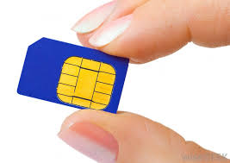
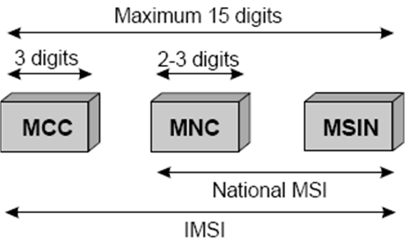
ITU-T E.212
Every mobile device in the world has a SIM card.
Denmark 238 - UK 234,235 - Ireland 272
Each SIM has a unique IMSI number
Registration, authentication, roaming
700+ networks with roaming agreements
Emerging business models for M2M (eCall, Smart Metering) and global communications services a challenge for existing E.212 structure and availability

Slide 7
Legal Basis for Numbering in Europe
Directives
Framework (efficient use . transparent, objective and non-discriminatory criteria for assignment etc)
Universal Service (access to non-geo numbers, 112, 116, number portability, charging principles)
Authorisation (authorisation required to access numbering resources)
Privacy (Directory Listings, Marketing Opt-In)
Standalone EC Decisions
E.g. Decision on 116 - Harmonised numbers for harmonised services of Social Value
National Legislation
ITU/ETSI/3GPP/IETF
Standards and Recommendations
Third CEPT workshop on “European Spectrum Management and Numbering”
ECO, 4 June 2014

Slide 8
Organisation of WG NaN
WG NaN is responsible for developing policies in numbering, naming and addressing and advising on technical regulatory matters to promote telecom innovation and competition
Structure of the ECC
WG NaN
Numbering & Networks
Chairman: Johannes Vallesverd (NOR)
Vice-Chairman: Vacant
PT TRIS
PT FNI
PT NP
PT ES
Technical
Regulatory Issues
Future
Numbering Issues
Number
Portability
Emergency
Services
Chairman:
Daniel Voisard (SUI)
Chairman:
Francesco Bernabei(IT)
Chairman:
João Feijó Silva (POR)
Chairman:
Florin Dragomir
(ROU)
Third CEPT workshop on “European Spectrum Management and Numbering”
ECO, 4 June 2014
Updated: June 2014

Slide 9
Headline Work Items
PT ES | PT FNI | PT NP | PT TRIS
Establishing criteria for the accuracy & reliability of 112 caller location information. | Evolution in the use of E.212. Mobile Network Codes | 3rd Party Use of NP Data. | Practical Approaches for Infrastructure Mapping
 | Numbering for eCall | Evolution in CLI usage - decoupling of rights of use of numbers from service provision. | Best practices for comparing IASQ
Third CEPT workshop on “European Spectrum Management and Numbering”
ECO, 4 June 2014

Slide 10
Thank you for your attention!
Contact:
Freddie McBride BBS MSc DipRegGov
freddie.mcbride@eco.cept.org
+45 33 89 63 22
European Communications Office:
www.cept.org/eco
Follow us on Twitter – @CEPT_ECC
Third CEPT workshop on “European Spectrum Management and Numbering”
ECO, 4 June 2014

